Slide 1
Projects In Express
CouchDB Overview & Installation

Slide 2
What Is CouchDB?
Open source NoSQL document database
Similar to MongoDB
Embraces The Web
Uses JSON to store data
Uses HTTP and MapReduce

Slide 3
Main Features
ACID Semantics
Built For Offline
Replication
Document Storage
MapReduce Views and Indexes
HTTP API

Slide 4
Document Example
{
“id”: “58755”,
“rev”:”5j5kj45k54”,
“name”: “John Doe”,
“address”: {
“street”: “4 Albany st”,
“city”: “New York”,
“state”:”NY”
}
}

Slide 5
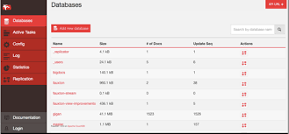
Fauxton
User Interface for…
Creating databases
Managing databases and collections
Creating MapReduce views and design documents
Initiate replication

Slide 6


